Slide 1
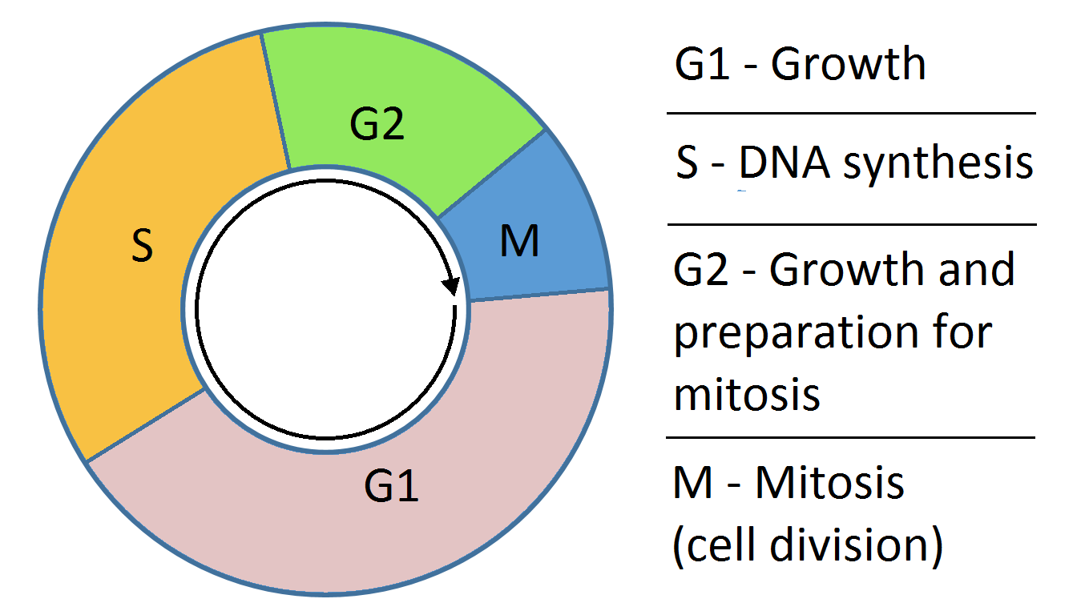
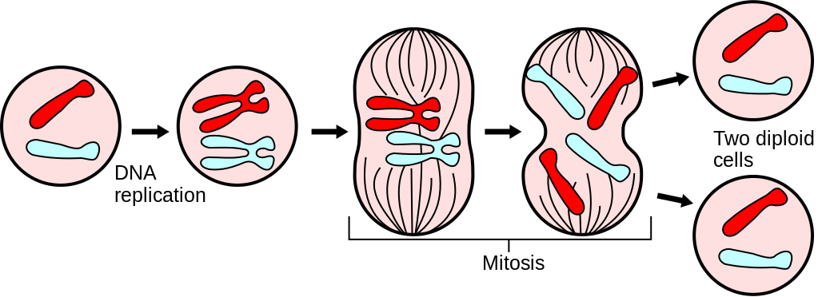
A Bifurcation Analysis on the Biochemical Switches of the G1-S Transition of the Mammalian Cell Cycle
Presented by: Mike Huang, Chih-Chi Liu

Slide 2
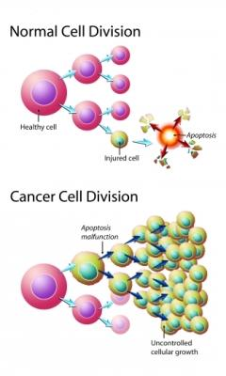
Background
Cell cycle contains many checkpoints
Ensures all of the requisite processes occurs before cell can proceed to the next phase of cycle
G1 phase prepares go signal for DNA replication
Errors result in uncontrolled growth - cancer

Slide 3
Biochemical Switches of the G1-S Transition
Phosphorylation Cascade
Phosphorylation Cascade
Transcription Factor Promoter Cyclin D
Transcription Factor
E2F-1
Transcription Factor Promoter Cyclin E
DNA synthesis (S-phase)
3

Slide 4
Cyclin D and Cancer
Cyclin D: an oncogene with pathogenic role in many tumors [2]
Overexpression of cyclin D found in several types of tumor formation [2]
4

Slide 5
Specific Aims of the Study
Study the contribution of cyclin D and cyclin E on cell proliferation and quiescnece by manipulating their synthesis and degradation rates
Rationale: Understand mechanisms for uncontrolled growth as well as to induce cell arest
Determine if the model can describe experimental observations
Rationale: Provides validation and thus confidence in the model to make predictions
Determine pharmacological interventions for cancer
Rationale: Lessen human suffering
5

Slide 6
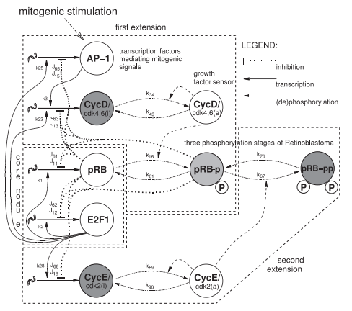
Methods - Model Schematic
G1-S progression
E2F-1 bound to tumor suppressor, pRB – cell quiescence
Input growth signal: Mitogenic stimulation promotes synthesis of transcription factor promoter, cyclin D
Two phosphorylation cascades promotes the phosphorylation of pRB in a two stage process:
Cyclin D:cdk4,6 complex
Cyclin E:cdk2 complex
Phosphorylation of pRB releases E2F-1 so that it’s active
DNA synthesis: S-phase – cell proliferation
6
Notes:
How they estimated the parameters

Slide 7
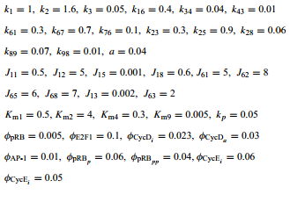
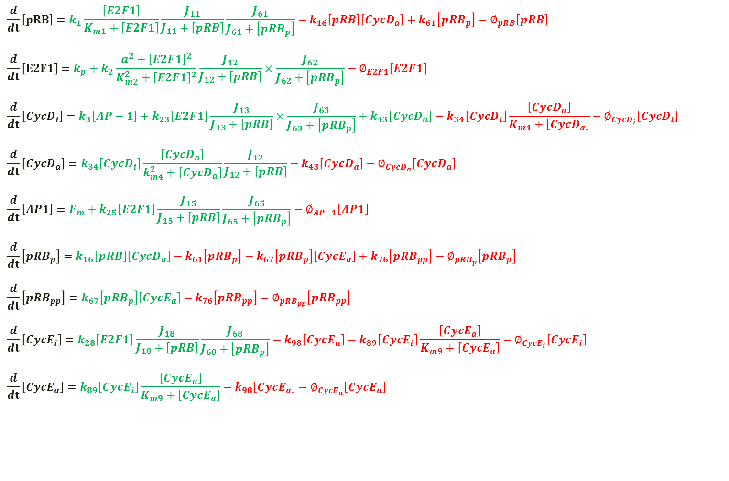
$$\frac{d}{dt}\left[pRB\right]=k_{1}\frac{\left[E2F1\right]}{K_{m1}+\left[E2F1\right]}\frac{J_{11}}{J_{11}+\left[pRB\right]}\frac{J_{61}}{J_{61}+\left[{pRB}_{p}\right]}−k_{16}\left[pRB\right]\left[{CycD}_{a}\right]+k_{61}\left[{pRB}_{p}\right]−∅_{pRB}\left[pRB\right]$$
$$\frac{d}{dt}\left[E2F1\right]=k_{p}+k_{2}\frac{{a^{2}+\left[E2F1\right]}^{2}}{K_{m2}^{2}+{\left[E2F1\right]}^{2}}\frac{J_{12}}{J_{12}+\left[pRB\right]}×\frac{J_{62}}{J_{62}+\left[{pRB}_{p}\right]}−∅_{E2F1}\left[E2F1\right]$$
$$\frac{d}{dt}\left[{CycD}_{i}\right]=k_{3}\left[AP−1\right]+k_{23}\left[E2F1\right]\frac{J_{13}}{J_{13}+\left[pRB\right]}×\frac{J_{63}}{J_{63}+\left[{pRB}_{p}\right]}+k_{43}\left[{CycD}_{a}\right]−k_{34}\left[{CycD}_{i}\right]\frac{\left[{CycD}_{a}\right]}{K_{m4}+\left[{CycD}_{a}\right]}−∅_{{CycD}_{i}}\left[{CycD}_{i}\right]$$
$$\frac{d}{dt}\left[{CycD}_{a}\right]=k_{34}\left[{CycD}_{i}\right]\frac{\left[{CycD}_{a}\right]}{k_{m4}^{2}+\left[{CycD}_{a}\right]}\frac{J_{12}}{J_{12}+\left[pRB\right]}−k_{43}\left[{CycD}_{a}\right]−∅_{{CycD}_{a}}\left[{CycD}_{a}\right]$$
$$\frac{d}{dt}\left[AP1\right]=F_{m}+k_{25}\left[E2F1\right]\frac{J_{15}}{J_{15}+\left[pRB\right]}\frac{J_{65}}{J_{65}+\left[{pRB}_{p}\right]}−∅_{AP−1}\left[AP1\right]$$
$$\frac{d}{dt}\left[{pRB}_{p}\right]=k_{16}\left[pRB\right]\left[{CycD}_{a}\right]−k_{61}\left[{pRB}_{p}\right]−k_{67}\left[{pRB}_{p}\right]\left[{CycE}_{a}\right]+k_{76}\left[{pRB}_{pp}\right]−∅_{{pRB}_{p}}\left[{pRB}_{p}\right]$$
$$\frac{d}{dt}\left[{pRB}_{pp}\right]=k_{67}\left[{pRB}_{p}\right]\left[{CycE}_{a}\right]−k_{76}\left[{pRB}_{pp}\right]−∅_{{pRB}_{pp}}\left[{pRB}_{pp}\right]$$
$$\frac{d}{dt}\left[{CycE}_{i}\right]=k_{28}\left[E2F1\right]\frac{J_{18}}{J_{18}+\left[pRB\right]}\frac{J_{68}}{J_{68}+\left[{pRB}_{p}\right]}−k_{98}\left[{CycE}_{a}\right]−k_{89}\left[{CycE}_{i}\right]\frac{\left[{CycE}_{a}\right]}{K_{m9}+\left[{CycE}_{a}\right]}−∅_{{CycE}_{i}}\left[{CycE}_{i}\right]$$
$$\frac{d}{dt}\left[{CycE}_{a}\right]=k_{89}\left[{CycE}_{i}\right]\frac{\left[{CycE}_{a}\right]}{K_{m9}+\left[{CycE}_{a}\right]}−k_{98}\left[{CycE}_{a}\right]−∅_{{CycE}_{a}}\left[{CycE}_{a}\right]$$
7

Slide 8
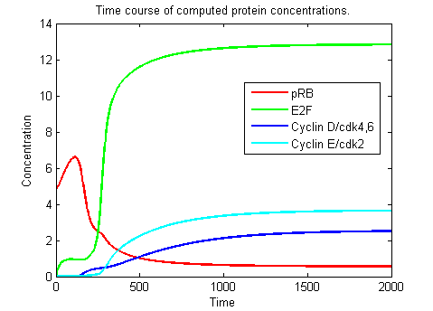
Bistability: A Switch to Cell Proliferation
Mitogenic Stimulation increased above threshold (Saddle Node)
E2F1 jumps to higher steady state (Bistability)
DNA Synthesis (S-phase)
Cell Proliferation
8

Slide 9
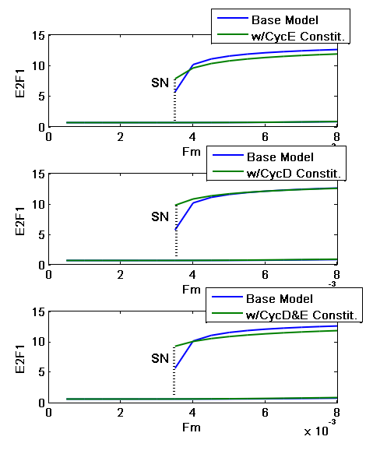

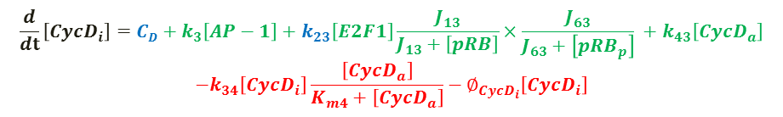
Adding Constitutive(Basal) Synthesis Rate to Cyclin D/Cyclin E
Motivation: Experimental studies involve overexpression of the constitutive synthesis rate
- Can this model describe experimental phenomena?
$$\frac{d}{dt}\left[{CycD}_{i}\right]={CD+k}_{3}\left[AP−1\right]+k_{23}\left[E2F1\right]\frac{J_{13}}{J_{13}+\left[pRB\right]}×\frac{J_{63}}{J_{63}+\left[{pRB}_{p}\right]} +k_{43}\left[{CycD}_{a}\right]$$
$$−k_{34}\left[{CycD}_{i}\right]\frac{\left[{CycD}_{a}\right]}{K_{m4}+\left[{CycD}_{a}\right]}−∅_{{CycD}_{i}}\left[{CycD}_{i}\right]$$
$$\frac{d}{dt}\left[{CycE}_{i}\right]={CE+k}_{28}\left[E2F1\right]\frac{J_{18}}{J_{18}+\left[pRB\right]}\frac{J_{68}}{J_{68}+\left[{pRB}_{p}\right]}$$
$$−k_{98}\left[{CycE}_{a}\right]−k_{89}\left[{CycE}_{i}\right]\frac{\left[{CycE}_{a}\right]}{K_{m9}+\left[{CycE}_{a}\right]}$$
9
Notes:
List 9 important components
Run through the mechanisms
Authors cite past experimental studies that rigorously determined a range of molecules and processes in the network
Authors selected nine of these components they “believed” to be the most important in controlling the G1-S transition

Slide 10
Assumptions and Limitations of the Methods
Parameters chosen to fit qualitative features observed experimentally
Thus the time course and amplitudes generated by the model are meaningless.

Slide 11
Assumptions and Limitations of the Methods
Constitutive:E2F1 dependent synthesis ratio unknown experimentally in normal healthy cell
Arbitrary ratio chosen
Through simulations, higher constitutive:E2F1 synthesis ratio leads to lower amplitude of the second steady state of E2F1. Since model is qualitative, this amplitude is meaningless and thus we argue that a realistic ratio is unnecessary.
10

Slide 12
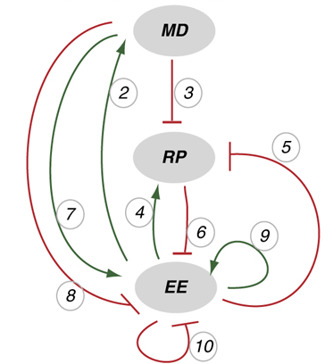
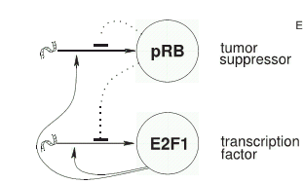
Assumptions and Limitations of the Methods
Validity of some of the mechanisms are questionable
Assumption: A double activation, double inhibition between pRB and E2F1 would generate bistability.
Newer study determined experimentally the minimal circuit required to generate bistability through blocking various gene pathways.[3]
Disparity ensues.
11

Slide 13
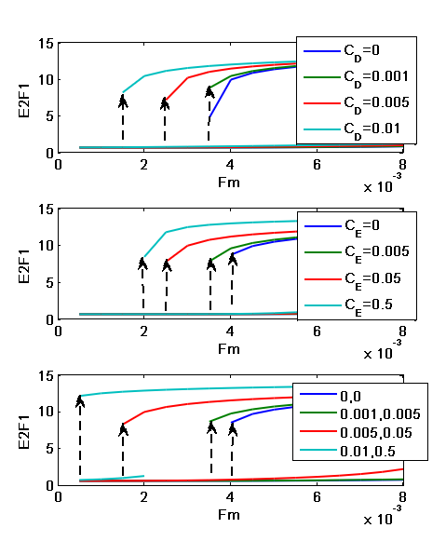
Results: Overexpression in the Cyclin D and Cyclin E Induces Cell Proliferation
Overexpressing the Constitutive Synthesis of Cyclins decrease the threshold of growth signal
Results found in observed experimental phenomena
Chinese hamster ovary cell: overexpression of cyclin E -> cell proliferation [4]
Rat esophageal tumor: found overexpression of both cyclin E and cyclin D [5]
12

Slide 14
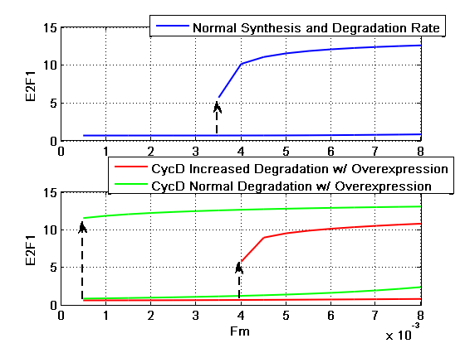
Results: Inducing Degradation of Cyclin D
Inducing degradation of cyclin D results in quiescence
ϕCycDi=0.023 -> 0.04
ϕCycDa=0.03 -> 0.05
Increasing degradation of Cyclin D shifted the SN to the right
14

Slide 15
Pharmaceutical Intervention to Induce Cell Arrest
Block expression of cyclin D/E [6] [7] [8]
Cyclin D: Troglitazone, anasamycin, monoterpenes
Cyclin E: 17alpha-ethinyl estradiol
Induce degradation of cyclin D
Hypothemycin, GL331, Reservatrol, Lovastatin
Conclusion
Ability to control cell proliferation and cell arrest by controlling the expression of cyclin D/E
Overexpression of cyclins -> cell proliferation
Repression of cyclins -> cell arrest
14

Slide 16
Limitations of Study
There is no quantitative data validation
The model is incomplete and simplified
Number of mechanisms and bimolecular interactions found in other paper is neglected
The model makes the assumption of double-inhibition double activation interactions between E2F1-pRB as a way to generate bistability
15

Slide 17
Path Forward
Study the significance of cdk2/cdk4,6 in the G1/S transition
Vary the activation and inactivation of cyclin E and cyclin D, respectively
k₃₄/k₄₃ for cyclin D and k₉₈/k₈₉ for cyclin E
Adding inhibitor to block cyclinE:cdk2/cyclinD:cdk4,6 complex
Study the negative feedback that leads to oscillations
17

Slide 18
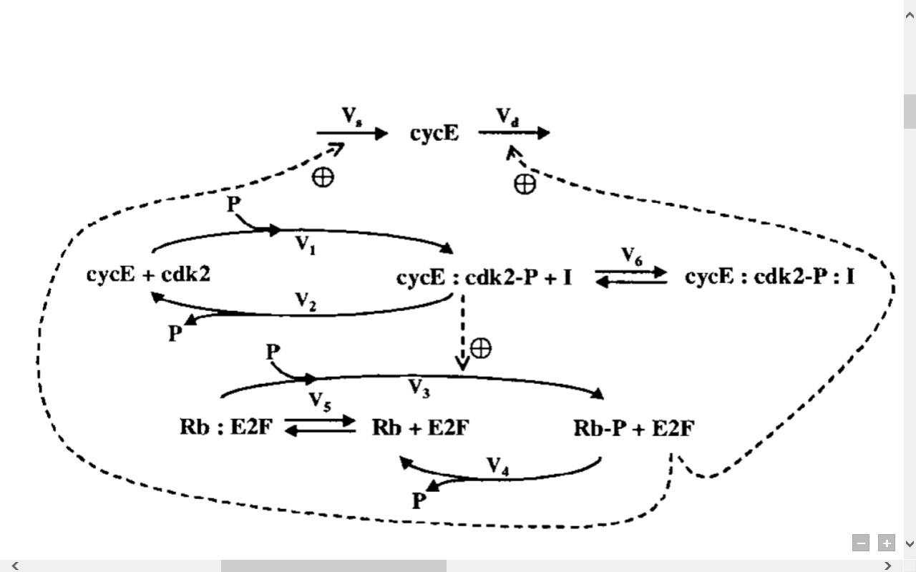
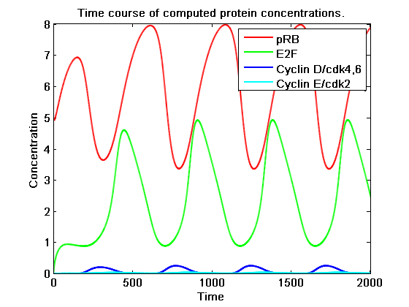
Negative Feedback to show cell cycle oscillation
Couple of positive feedback mechanism to a negative feedback loop shows cell cycle oscillation [9]
Require more study to develop the mechanism on how cyclins are regulated by E2F
17

Slide 19
Thank you for your time!
Any Questions?
18

Slide 20
Citation
[1] Swat, M., Kel, A., & Herzel, H. (2004). Bifurcation analysis of the regulatory modules of the mammalian G1/S transition. Bioinformatics, 20, 1506-1511
[2]Stamatakos, M., Palla, V., Karaiskos, I., Xiromeritis, K., Alexiou, I., Pateras, I., et al. (2010). Cell cyclins: triggering elements of cancer or not?. World Journal of Surgical Oncology, 8, 111.
[3]Yao, Guang, Cheemeng Tan, Mike West, Joseph R Nevins, and Lingchong You. "Origin of bistability underlying mammalian cell cycle entry." Molecular Systems Biology 7 (2011): 23. Print.
[4] Renner W, Lee KH, Hatzimanikatis V, Bailey JE, Eppenberger H. 1995. Recombinant cyclin E expression activates proliferation and obviates surface attachment of Chinese hamster ovary (CHO) cells in proteinfree medium. Biotechnol Bioeng 47:476–482
[5]Alao, J. P. (2007). The regulation of cyclin D1 degradation: roles in cancer development and the potential for therapeutic invention. Molecular Cancer, 6(1), 24.
[6] He G, Thuiller P, Fischer SM, (2004). Troglitazone inhibits cyclin D1 expression and cell cycling independently of PPARgamma in normal mouse skin keratinocytes. J Invest Dermatol, 2004 Dec;123(6):1110-9
[7] Bardon, S., Picard, K., & Martel, P. (1998). Monoterpenes Inhibit Cell Growth, Cell Cycle Progression, And Cyclin D1 Gene Expression In Human Breast Cancer Cell Lines. Nutrition and Cancer, 32(1), 1-7.
[8] Basso, A. D., Solit, D. B., Munster, P. N., & Rosen, N. (2002). Ansamycin antibiotics inhibit Akt activation and cyclin D expression in breast cancer cells that overexpress HER2. Oncogene, 21(8), 1159-1166.
[9] Hatzimanikatis, V., Lee, K. H., & Bailey, J. E. (1999). A mathematical description of regulation of the G1‐S transition of the mammalian cell cycle. Biotechnology and Bioengineering, 65, 631-637.
20

